Slide 1
Revolt Currency Exchange
BDAT 1004
Group 12

Slide 2
Agenda
Team Member
Project Summary
Demonstration

Slide 3

Team Member

Slide 4
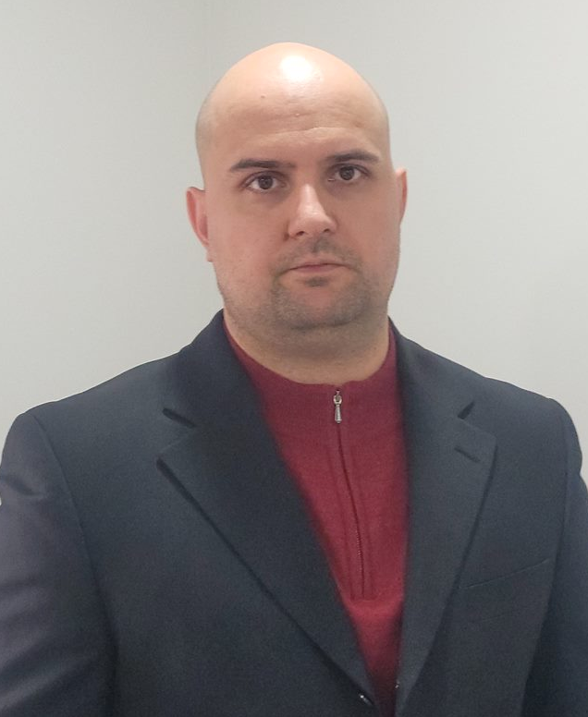
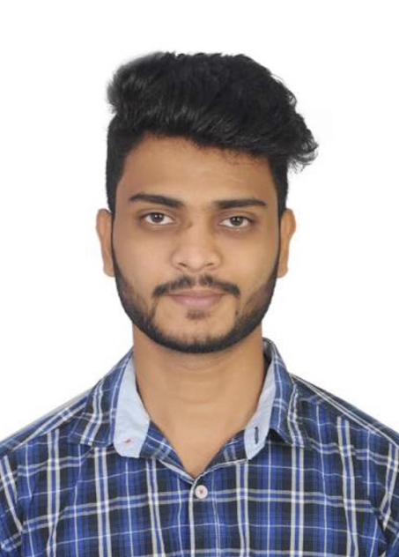
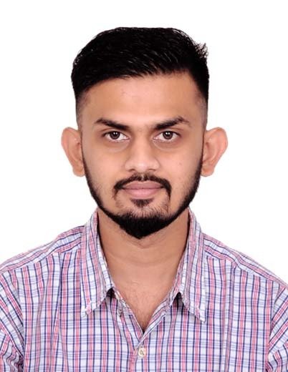
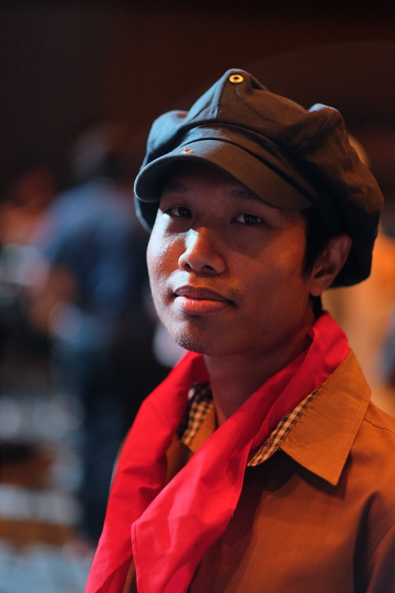
Team Member
Artem Safarian
B.A. Business and Society
TESOL
Business Analyst
Krishna Chaitanya Reddy Alla
Bachelors in Information Technology
Data Analyst
Milind Satishkumar Tank
Bachelors in Information Technology
Developers
Tin Srimake
Bachelors and Master’s in the environmental field
Project Manager

Slide 5
Project Summary

Slide 6
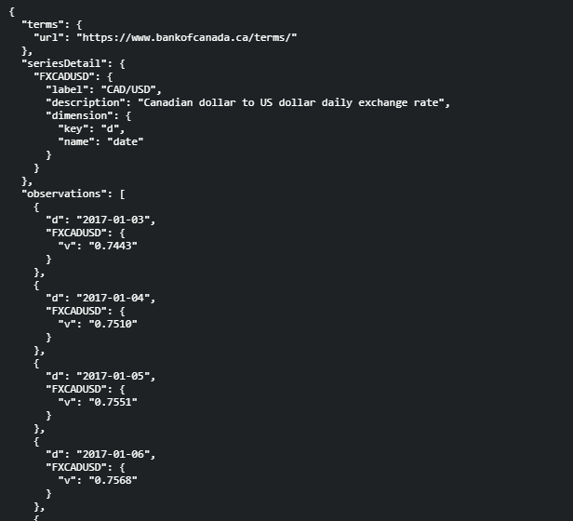
Live data(JSON)

Slide 7
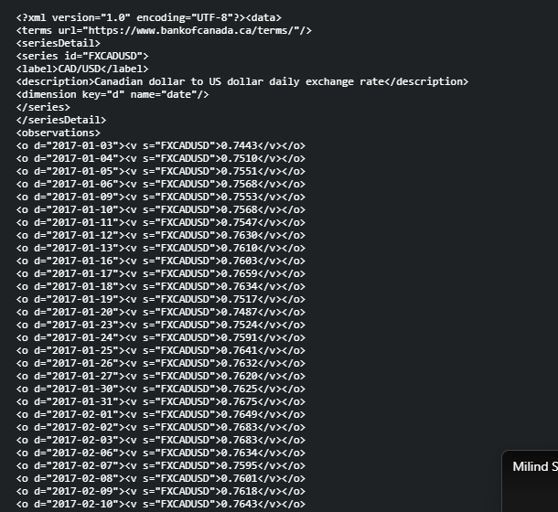
Live data(XML)

Slide 8
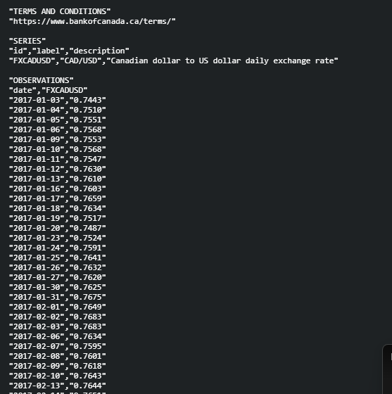
Live data(CSV)

Slide 9
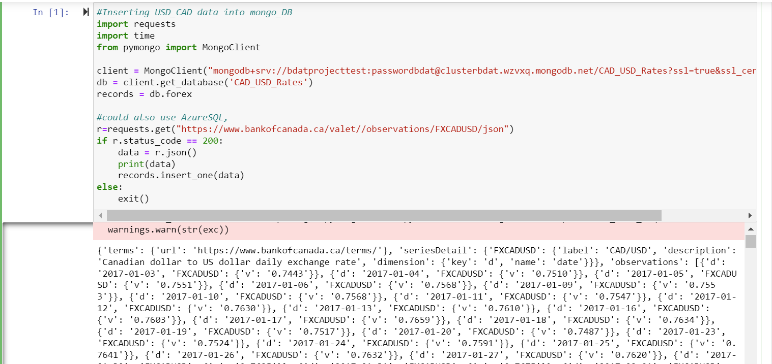
Acquire data by using python

Slide 10
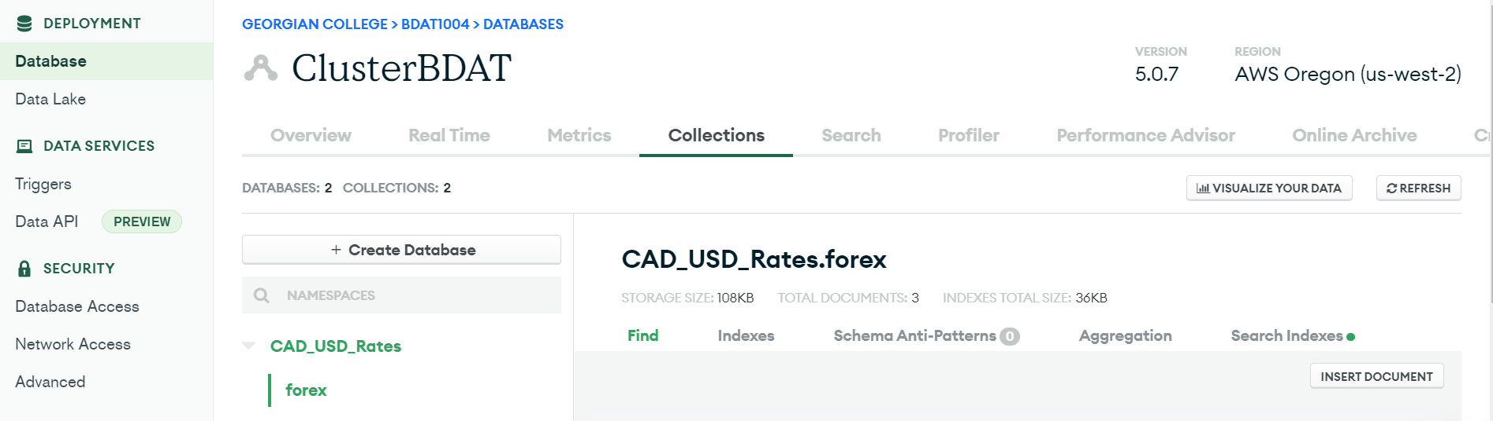
Cloud database(MongoDB)

Slide 11
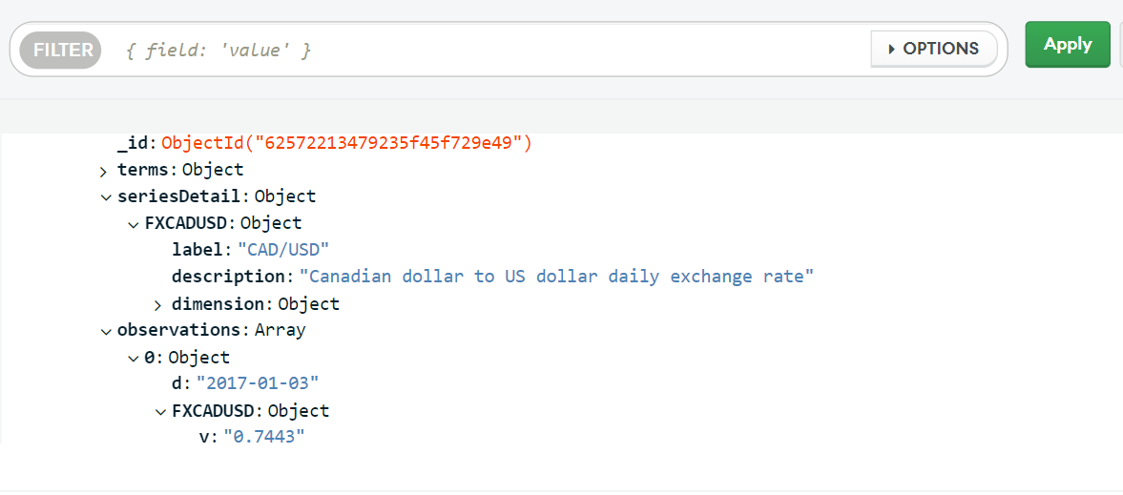
Pseudo-batch process

Slide 12
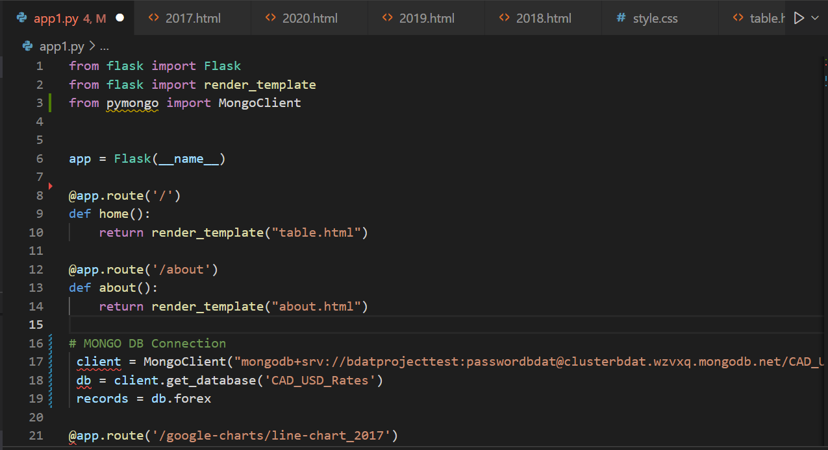
Flask Framework

Slide 13
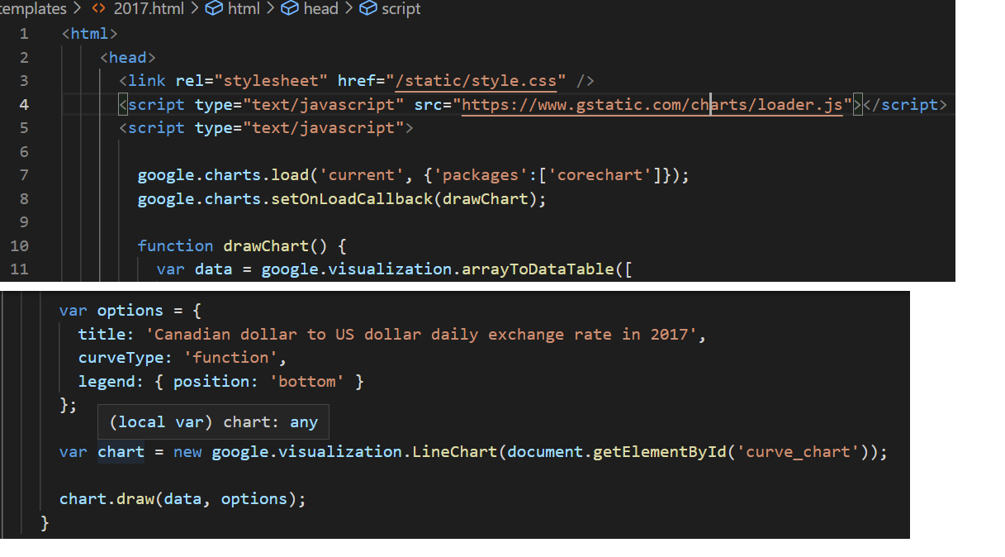
Google charts

Slide 14
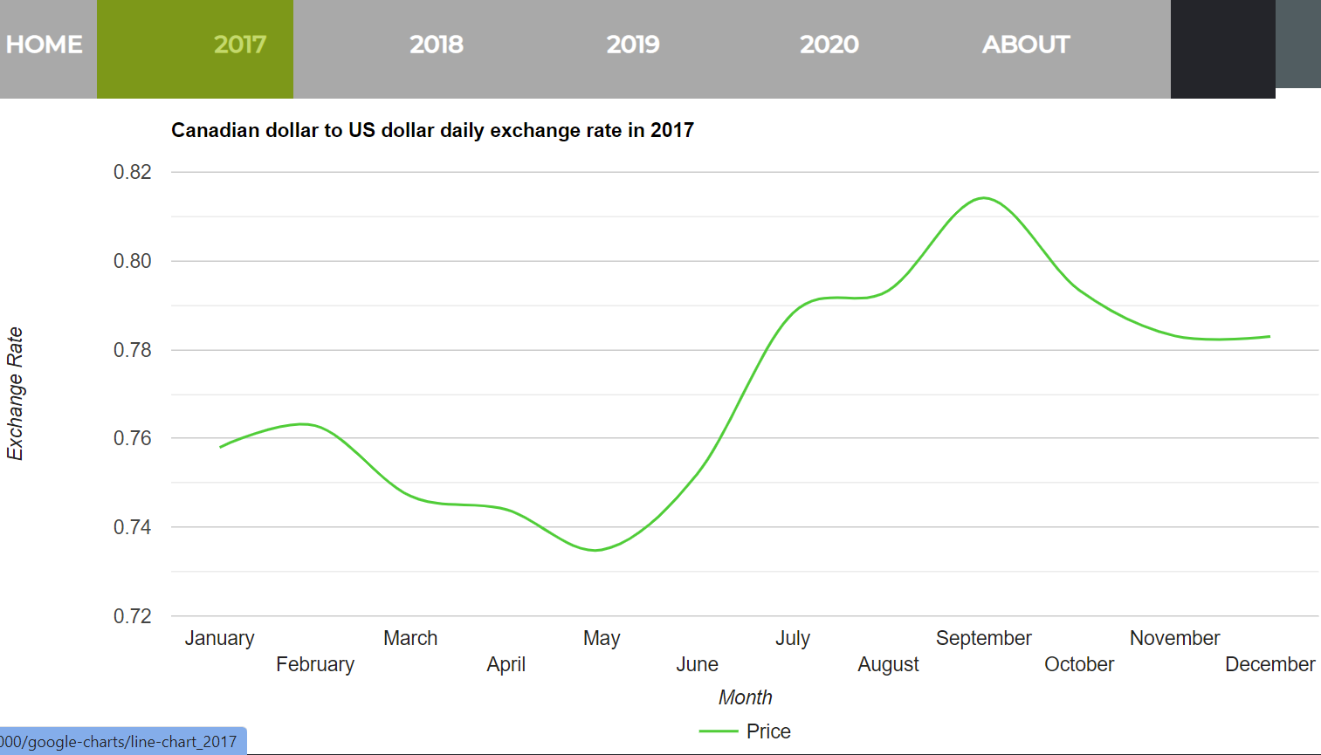
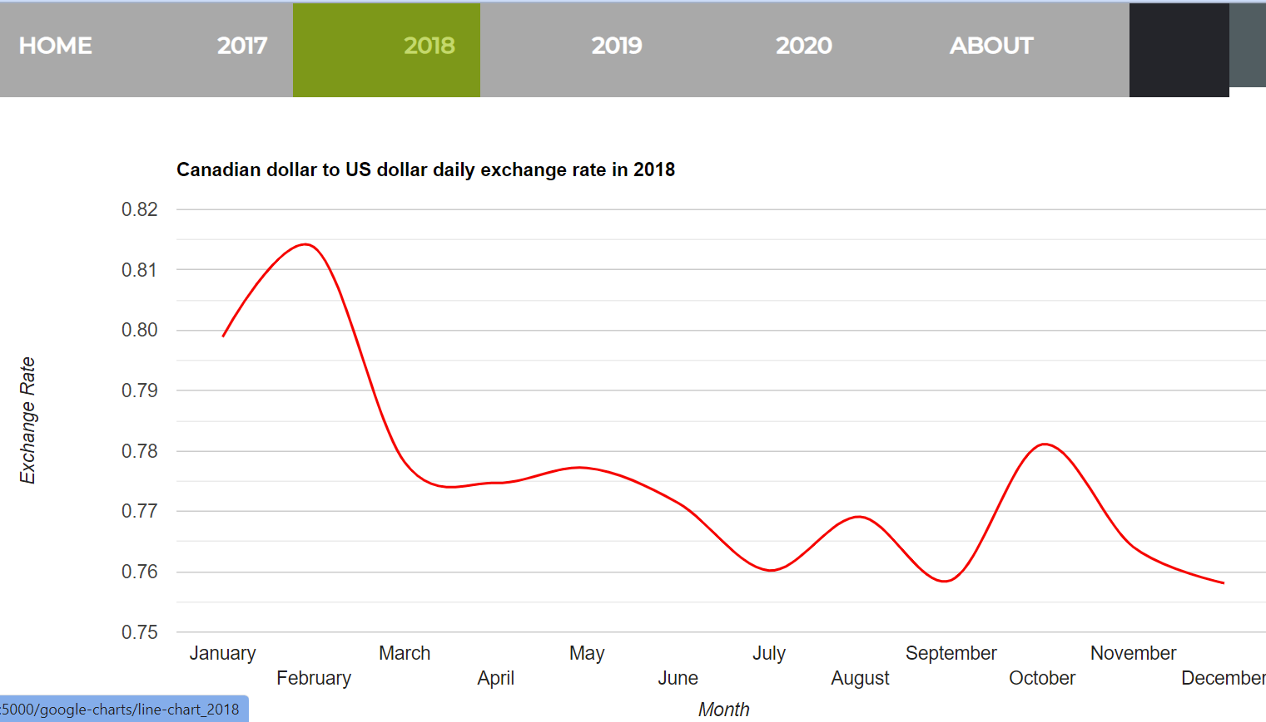
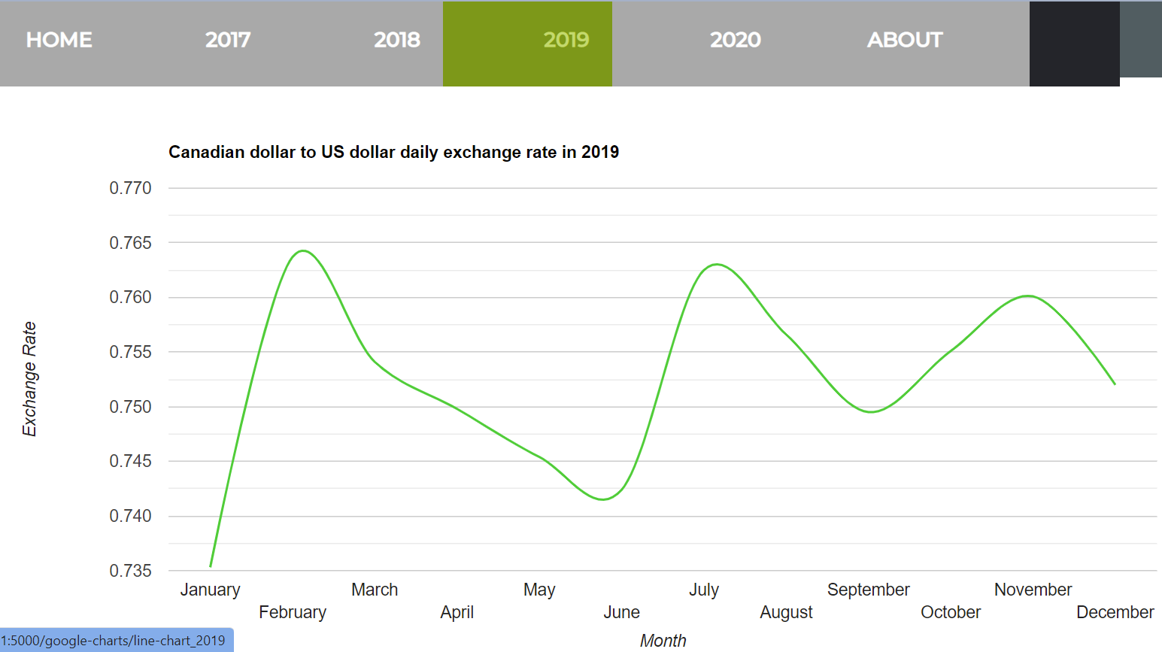
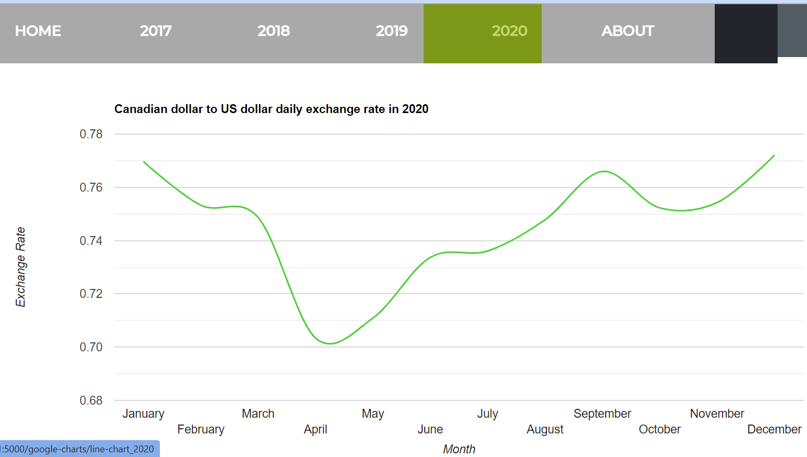
Example of the chart

Slide 15
Bonus

Slide 16
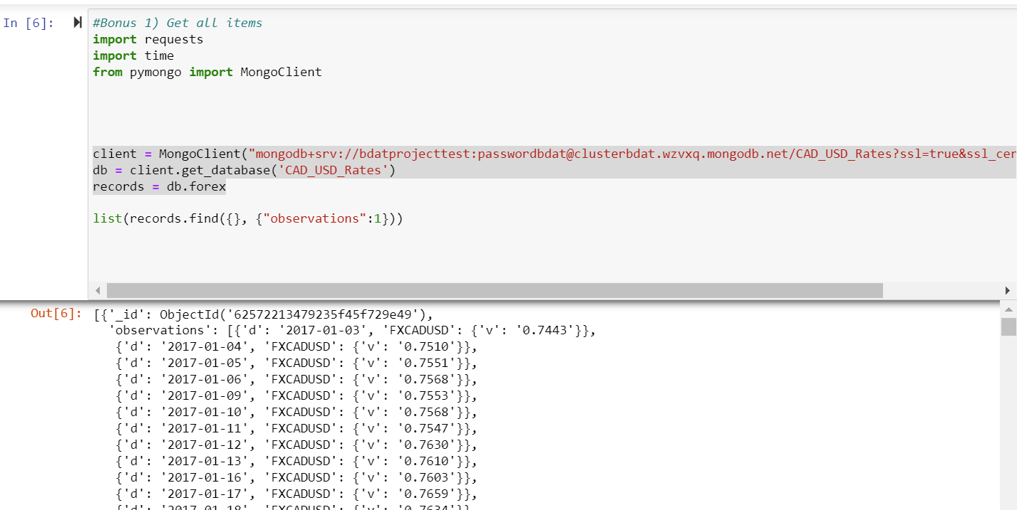
Get all items

Slide 17
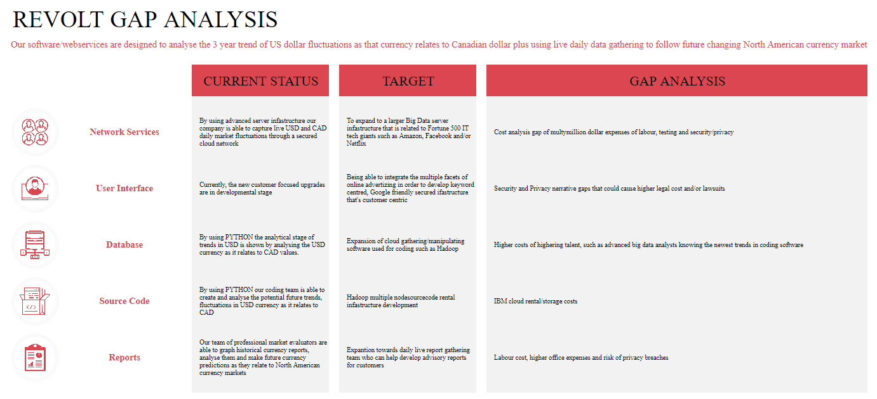

Slide 18
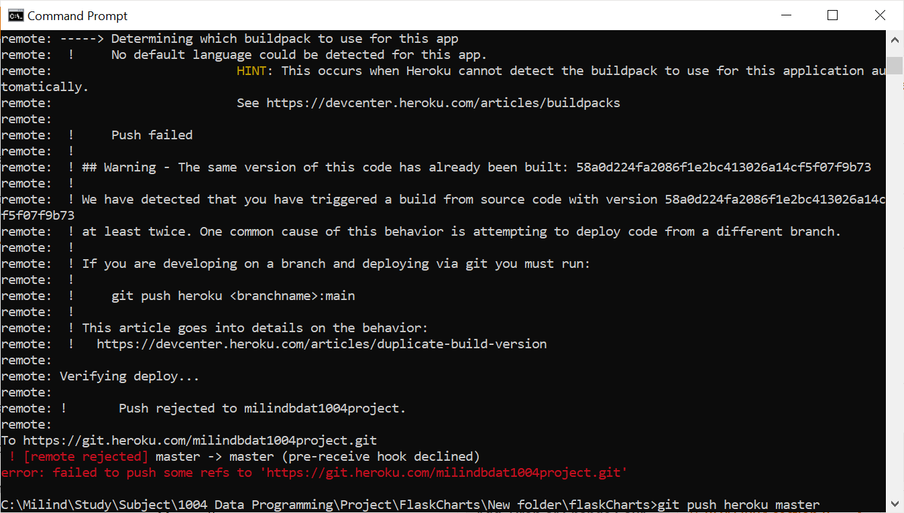
Use a URL to access the API and test https://bdat1004finalprojectgroup12.herokuapp.com/

Slide 19
Demonstration

Slide 20

Questions

